Slide 1
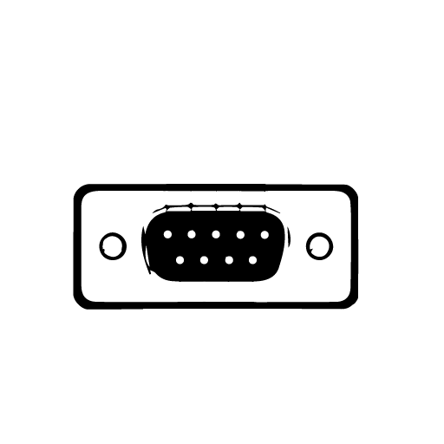
Investigation of rs-232 communication interface
Presentation By džiugas pečiulevičius, pi18e

Slide 2
Objective
Objective is to investigate and understand how RS-232 communication interface works and have a look over a DB9 port.

Slide 3
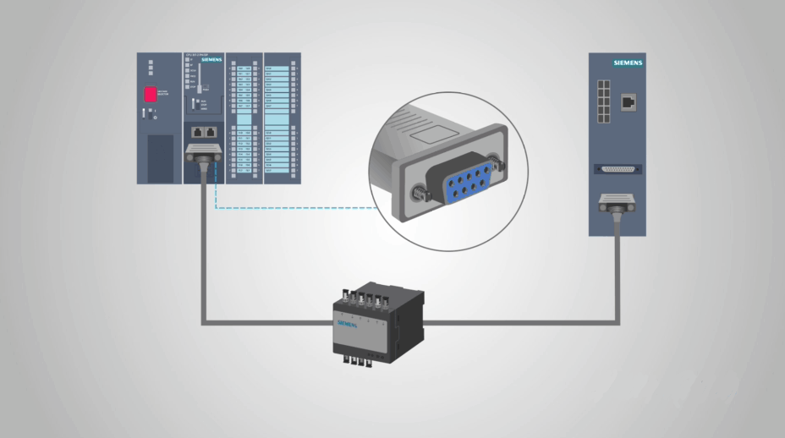
What is rs-232?
RS-232 is a form of serial data transmission, or in other words it‘s a form of communication. “RS” standing for “Recommended Standard”. DB-9 cable was used for RS-232 transmissions.
RS-232 communicates data one bit at a time (Asychronous communication), unlike a parallel (Synchronous) interface that sends multiple bits simultaneously. The key benefit of this is that serial communication is less complicated and requires fewer wires.
Today, many of these applications have switched to USB or wireless connections. However, RS-232 is still used heavily in automation, servers, networking, industrial communications, and many other applications.
Notes:
So RS-232 is a form of serial protocol that is used to send data bits. It was originally designed to send data between computes using modems and telephone lines. RS-232 communicates data one bit at a time. Sending more bits at a time would be called parallel. The benefit of RS-232 is that its less complicated and requires fewer wires. These days many of these applications have switched to USB or wireless connections. RS-232 is still used in automation, servers, networking, industrial communications and many other applications.

Slide 4
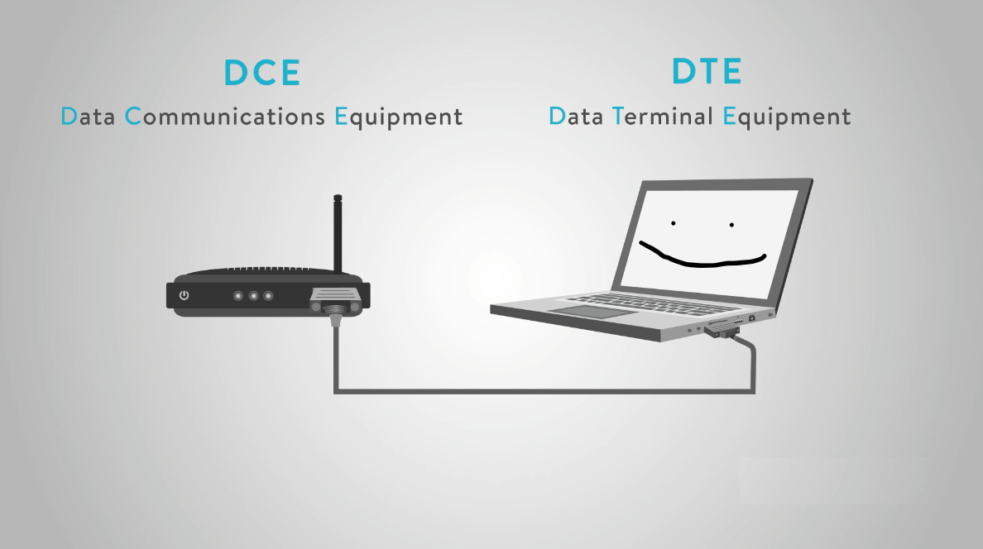
DTE AND DCE COMMUNICATIONS
There are two different types of RS-232 devices. DTE and DCE. DTE stands for Data Terminal Equipment. It’s a common example of this is a computer. DCE stands for Data Communications Equipment. And a common example for this would be a modem.
Notes:
RS-232 has two different types of devices. DTE and DCE. DTE – Data Terminal Equipment and DCE – Data Communications Equipment. A common example for each would be a modem for DCE and a compputer for DTE.

Slide 5
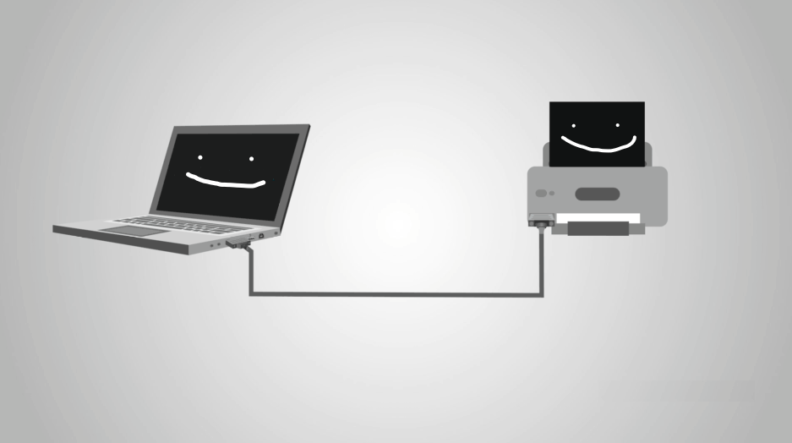
DTE AND DCE COMMUNICATIONS
A very common example is that many people are probably familiar with is a computer connected to a printer. While USB has become the standard, RS-232 is still widely used for older printers in the workplace.
The RS-232 protocol and cable allow the computer to give commands to the printer via a voltage signal which are 0 and 1’s. The printer deciphers those commands and completes the print.
Notes:
A common example of DTE and DCE communications would be a workplace with computers and printers. The RS-232 protocol and cable allows the computer to give commands to the printer via a voltage signal which are 0 and 1’s. The printer deciphers those commands and completes the print.

Slide 6
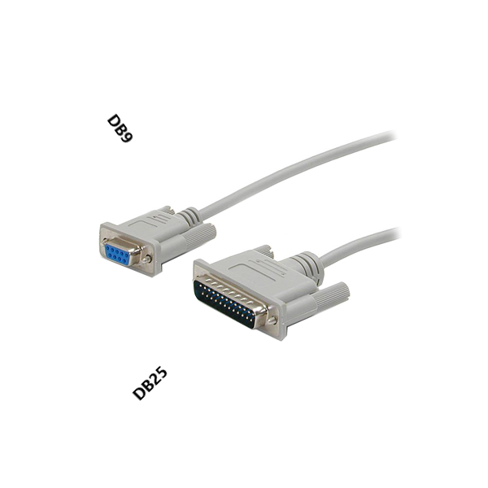
DB9 connector
There are two connector sizes used for RS-232: DB9 and DB25. In both cases, RS-232 connects a Data Terminal Equipment end (DTE, the transmitter) to a Data Communication Equipment end (DCE, the receiver).
The 9 pin connector seems to be a little more common these days. The table below shows the description and abbreviation for each pin.
Notes:
9 pin connector seems to be more common these days. These connectors are used for RS-232. They connect DATA TERMINAL EQUIPMENT end which is called DTE, the transmitter and it connects to a DATA COMMUNICATION EQUIPMENT end which is called DCE, the receiver.

Slide 7
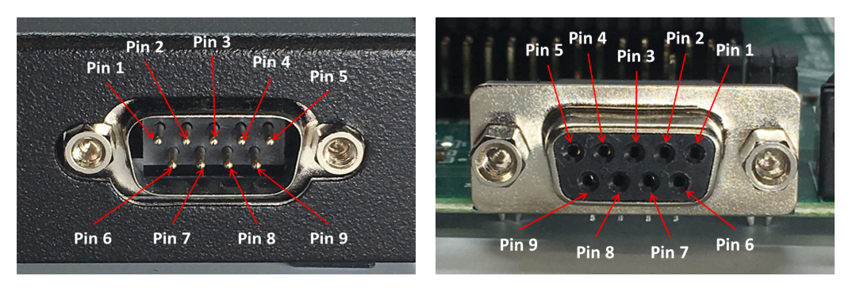
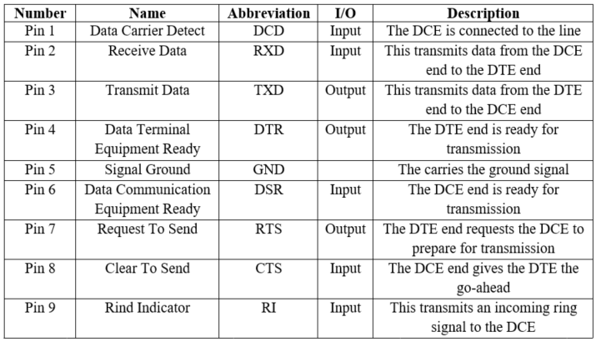
The column labeled “I/O” specifies the data direction from the male connector.
Male DB9
Female DB9
Notes:
So basically this is the male and female DB9 connectors. I/O shows the data flow direction from male connector.
1st pin (Data Carrier Detect pin) – Incoming signal from DCE
2nd pin (Receive Data pin) – Receives incoming data from DTE.
3rd pin (Transmit Data pin) – Send outgoing data to DCE
4th pin (Data Terminal Equipment Ready pin) – Outgoing handshaking signal
5th pin (Signal ground pin)– Common reference voltage
6th pin (Data Communication Equipment Ready pin) - Incoming handshaking signal
7th pin (Request To Send pin) – Outgoing signal for controlling flow
8th pin (Clear To Send pin) – Incoming signal for controlling flow
9th pin (Rind Indicator pin) – Incoming signal from DCE
What is Handshaking?
Handshaking is the process which is used to transfer the signal from DTE to DCE to make the connection before the actual transfer of data. The messaging between transmitter & receiver can be done by handshaking.

Slide 8

ADVANTAGES OF RS-232 SERIAL COMMUNICATION PROTOCOL
RS-232 is remarkable for its simplicity and low cost. It is used by many legacy devices and is favorable in many point-to-point applications when no further complexity is needed such as in industrial control equipment.
Unlike USB, the most common modern alternative, maximum RS-232 cable lengths are dependent upon capacitance. However, a standard rule of thumb is that cables of us to 15 meters are generally supported, while USB can support 3 to 5 meters. RS-232 also handles noise better than many other protocols.
Notes:
The advantages are:
-RS-232 is simple and low cost.
-Can be used for legacy devices.
-Compared to USB RS-232 has a higher cable limit which is 15 meters compared to USB which has 3 to 5 meters.
-RS-232 also handles noise better than many other protocols.

Slide 9

DISADVANTAGES OF RS-232 SERIAL COMMUNICATION PROTOCOL
From a more technical perspective, the protocol is only appropriate for system-to-system communications in the single-master-single-slave configuration. Any communication with multiple chips or sensors on one end or with a more complex configuration will not be supported by RS-232.
The speed at which data can be transferred. Data can be transferred at around 20 kilobytes per second (20 KB/s). Which is pretty slow compared to what people are used to nowadays. Another issue with RS-232 is that the maximum length a cable is about 15 meters. Wire resistance and voltage drops become an issue with cables longer than this. This is one reason RS-232 is not used much as newer technology for remote installations.
Notes:
The disadvantages are:
Communications with multiple chips or sensors on one end or with more complex configuration will not be supported by RS-232
It‘s pretty slow which is around 20 kilobytes per second compared to what people are used to nowadays.
Another issue with RS-232 is that the maximum length a cable is about 15 meters. It becomes a problem when wire resistance and voltage drops become an issue with cables longer than this. And this is one of the main reasons why RS-232 is not used so much as newer technology for remote installations.

Slide 10
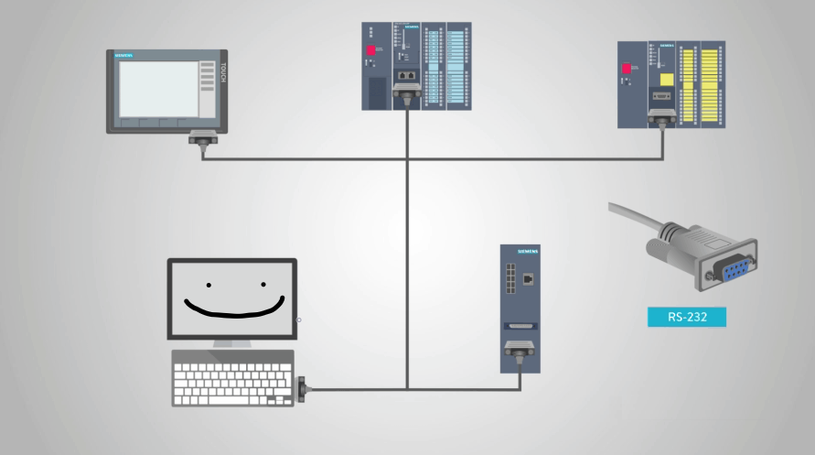
Conclusions
For years, RS232 has been a standard in industry. Today, USB and Ethernet have started to phase out this older serial communication standard.
However, with the help of simple adapters, devices can still talk to each other using the new and old standards.
There are still many manufacturers using RS232 since it has always been widespread and inexpensive.
Keeping in mind that RS232 is simply a form of serial communications, or a way to transmit data. A standard DB9 cable is probably the most used cable for this application.
Notes:
CONCLUSIONS:
- RS-232 has been a standard in the industry, but USBs and Ethernet are replacing RS-232.
- RS-232 can still communicate using simple adapters.
- RS-232 is still being used by many manufacturers since it‘s pretty inexpensive and widespread.
- RS232 is form of serial communications, or a way to transmit data. A standard DB9 cable is probably the most used cable for this application.

